Slide 1


Task 3_Final Content Data set

Slide 2


Today's agenda
Project recap
Problem
The Analytics team
Process
Insights
Summary

Slide 3

Social Buzz is a fats growing technology unicorn that need to adapt quickly to its global scale.
Accenture has begun a 3 month POC focusing on these tasks:
An Audit of Social Buzz’s big data practice
Recommendations for a successful IPO
Analysis to find Social Buzz’s top 5 Most Popular Categories of Content
Project Recap

Slide 4


Problem
Over 1,00,000 posts per day
36,500,000 pieces of content per year
Most popular Category with highest reaction?
Month with most number of Posts?
Category with least number of posts?
Yearly post distribution?

Slide 5



Data Understanding
Andrew Fleming
Chief Technical Architect
The Analytics team
Marcus Rompton
Senior Principle
Ramkuvar Prajapati
Data Analyst

Slide 6
Process
1
Data Understanding
2
Data Cleaning
3
Data Modelling
4
Data Analysis
5
Uncover Insights

Slide 7

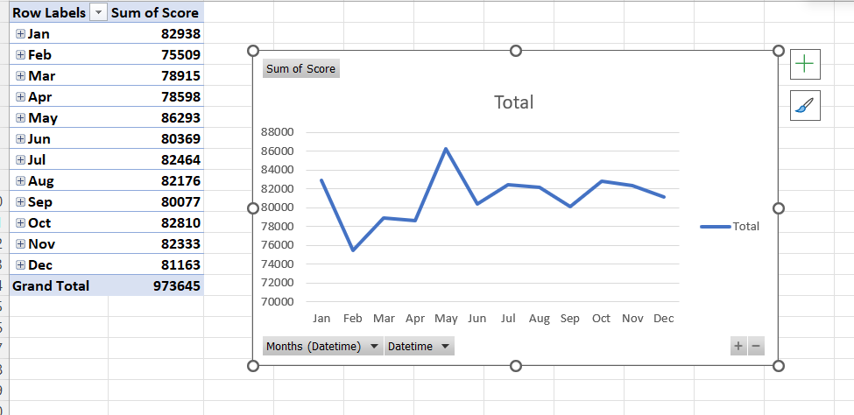
Insights
"The month with the most posts is 'May' with 86293 posts."

Slide 8
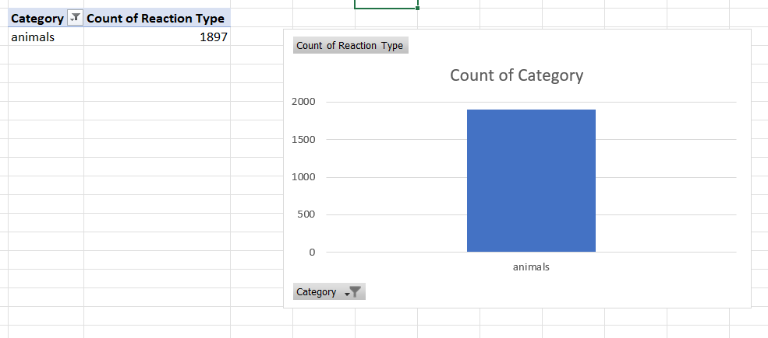
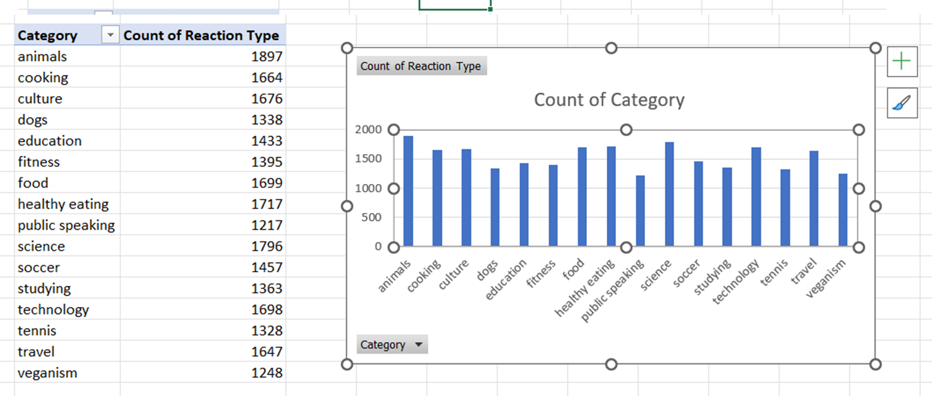
Insights
"The most popular category is 'Animals' with 1897 reactions."

Slide 9
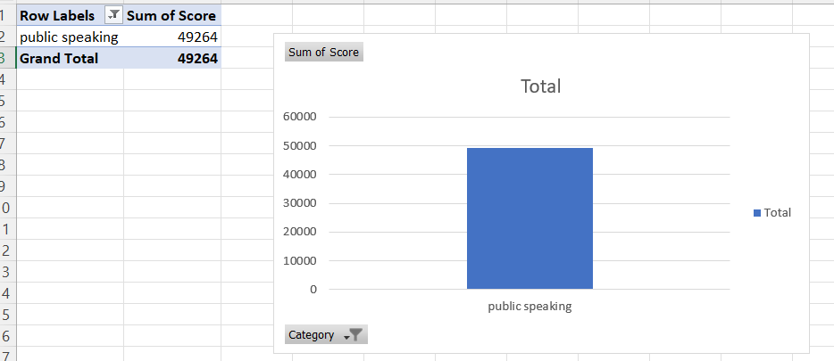
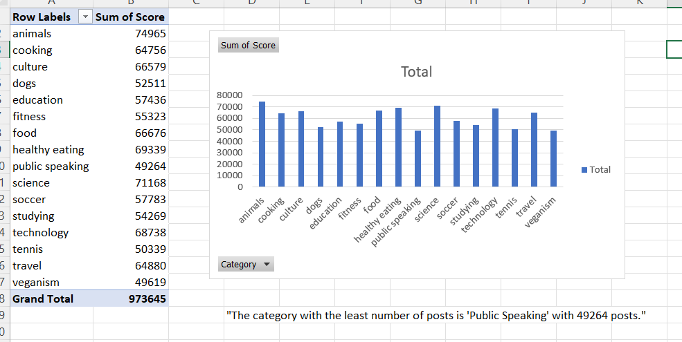
Insights

Slide 10
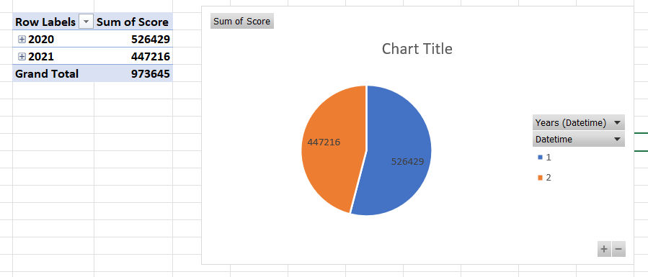
Insights
The post distribution over the years is as follows: 2021 - 447216 posts, 2020 - 526429 posts."

Slide 11

In this presentation, we explore key findings from our recent data analysis project. Our team discovered that May was the most active month with 86,293 posts, while the 'Animals' category received the highest engagement with 1,897 reactions. Notably, there were 526,429 posts in 2020 and 447,216 in 2021. These insights help us understand posting trends and audience engagement, providing a foundation for future strategies. We conclude with a summary of our findings and invite questions from the audience.
Summary

Slide 12

Thank you!
ANY QUESTIONS?

